Slide 1
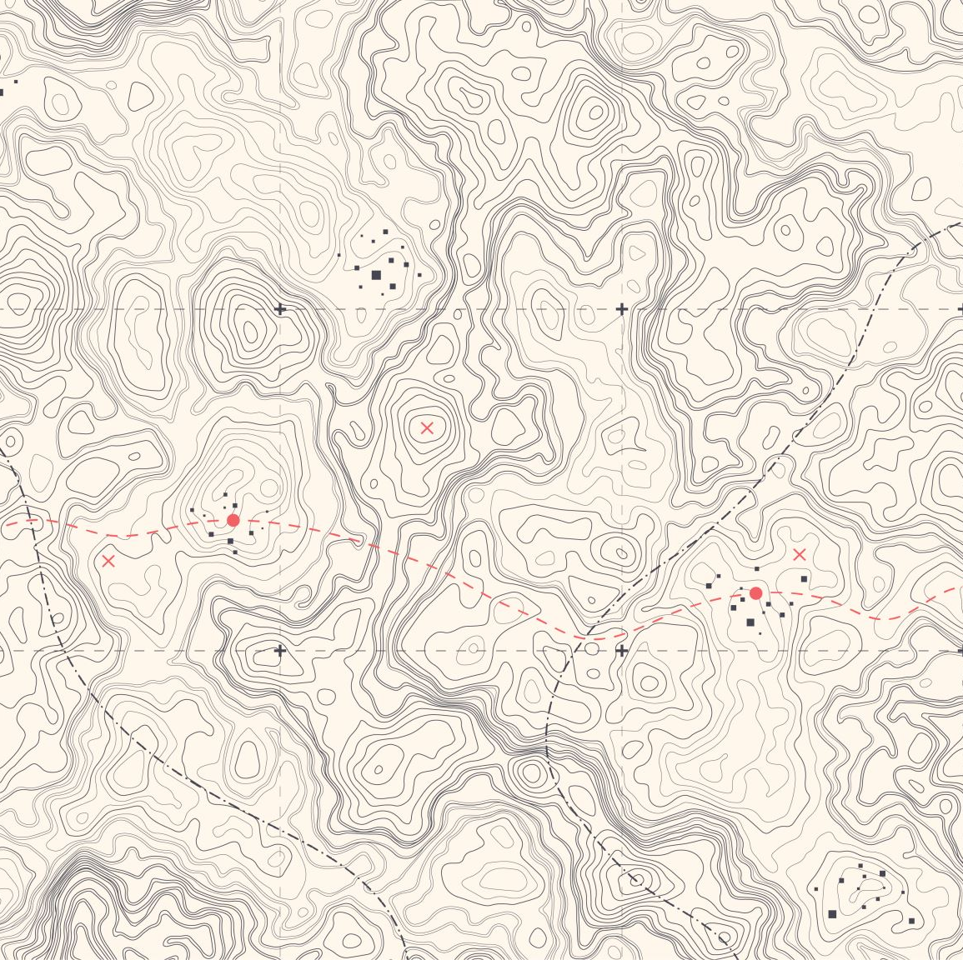
Geographically Enhanced Search with Terrain Enhanced Location Targeting [GESTALT]
Kent O’Sullivan
CMSC828T
Major Project Presentation
11 May 23

Slide 2
Scope
Motivation
Background
Architecture
Implementation
Evaluation
Future Work

Slide 3
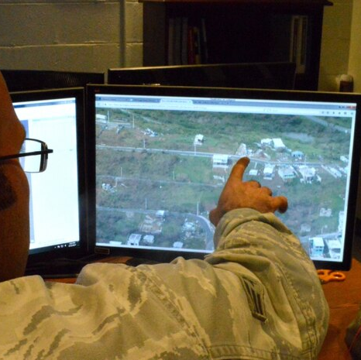
Motivation
We spend a lot of time ’finding’ places.
Current solutions can give us an exact match or a shortlist.
Current solutions don’t do well with partial information
Humans currently fill the gap. Why should we?
Image Source: US Army Corps of Engineers

Slide 4
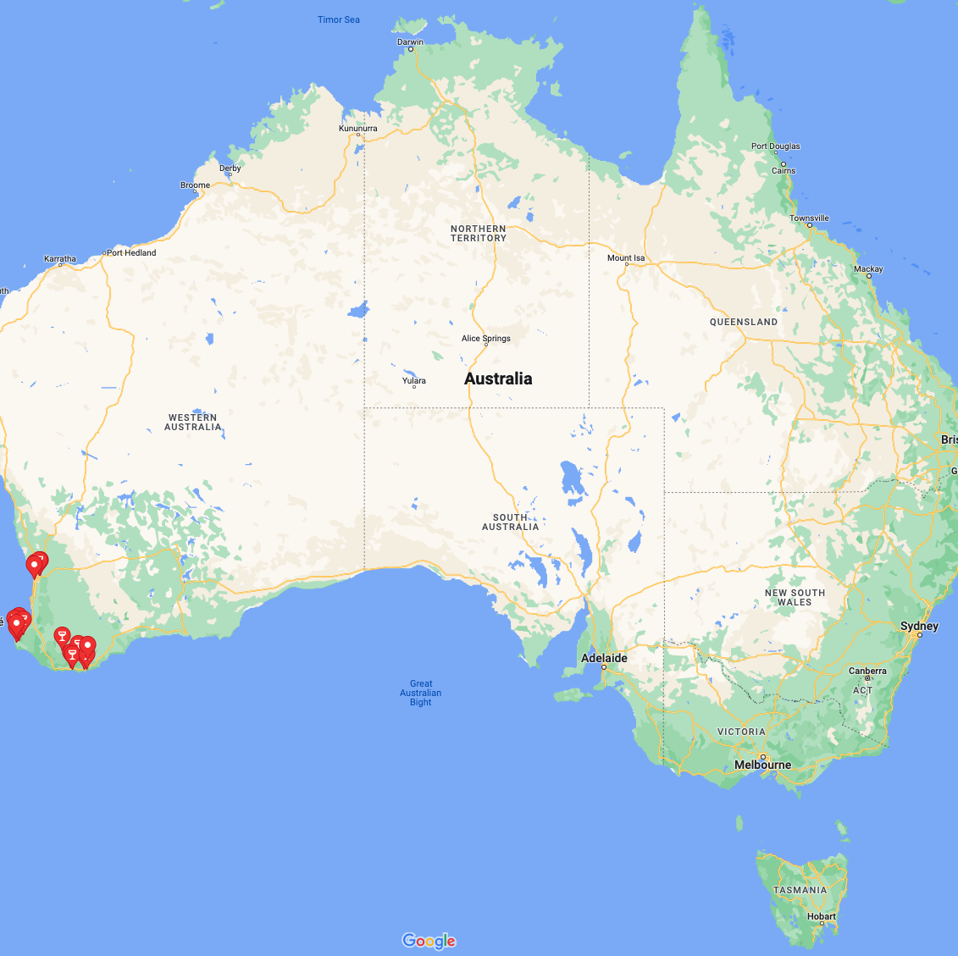
On the merits of wine tours
No Planning
No Navigation
No Driving
No Worries!
But where did I go again?

Slide 5
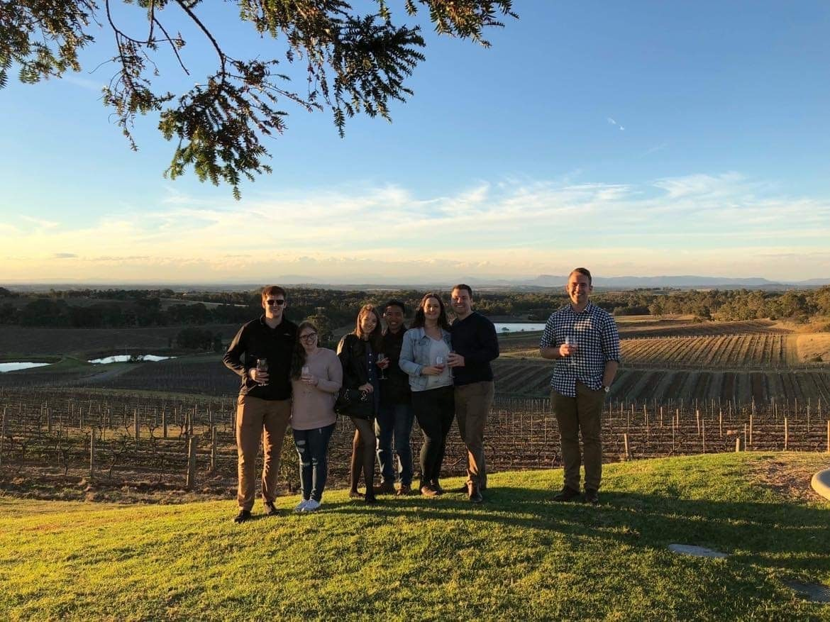

Slide 6
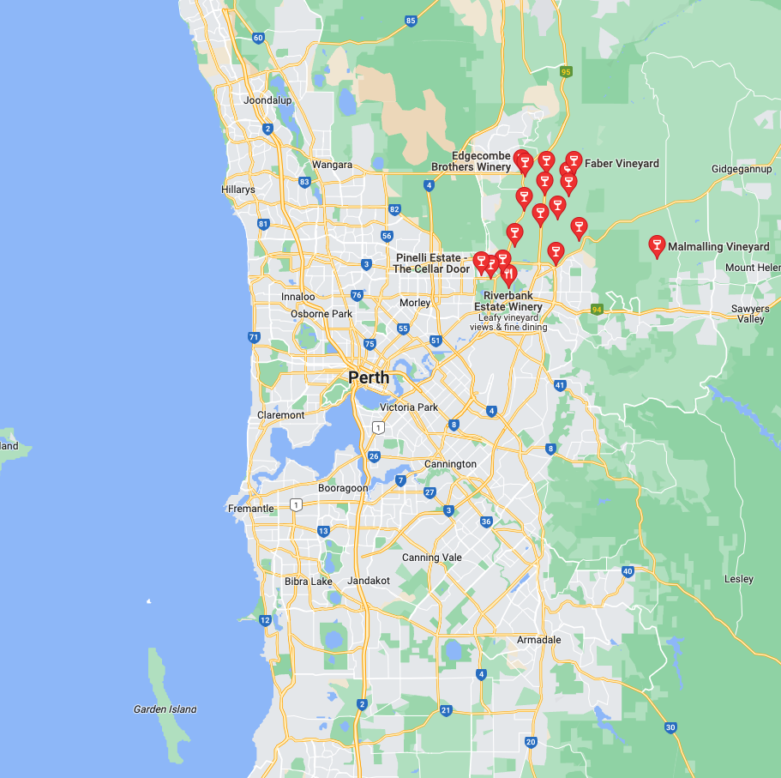
Which wineries?
I visited four on the tour…
I definitely went to Oakover Grounds where that photo was taken…
I remember an excellent Verdelho on some tables made of wine barrels…
I remember a very average Chenin Blanc surrounded by palm trees…
Oh and that one place that had the buzzing generator, that was awful…

Slide 7

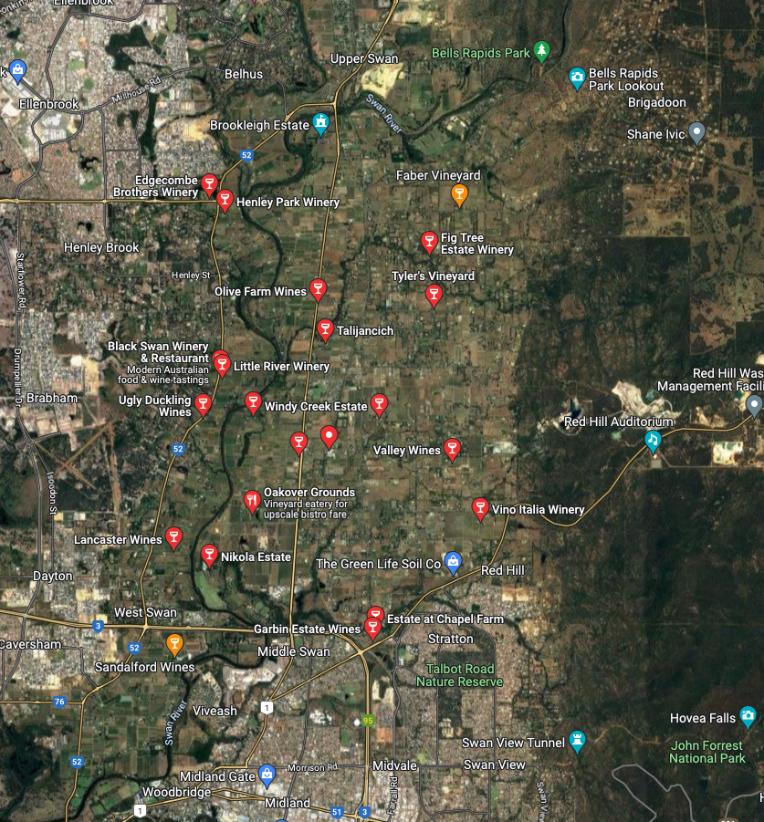
Typical Workflow for last-mile search
Here you go:
What wineries are in Swan Valley, WA
31 Matches Found
Wineries with Wine Barrell Tables
31 Matches Mention “Wine” and “Table” in their description
Ugh.. Just show me the satellite map.

Slide 8
Yikes… I guess I just go one at a time

Slide 9
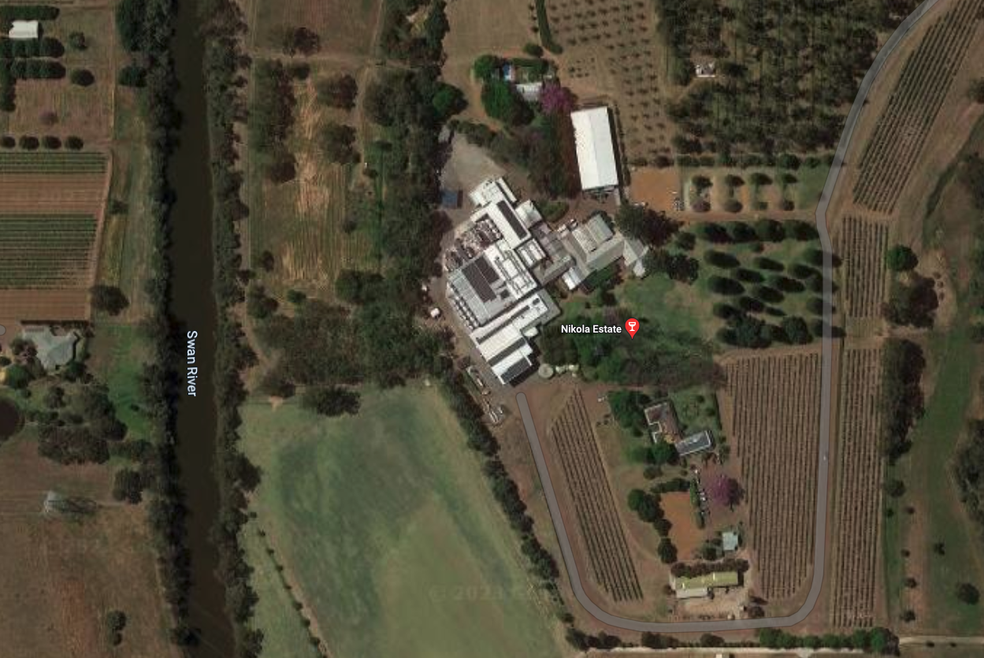
Hmmm… I don’t think it was this one

Slide 10
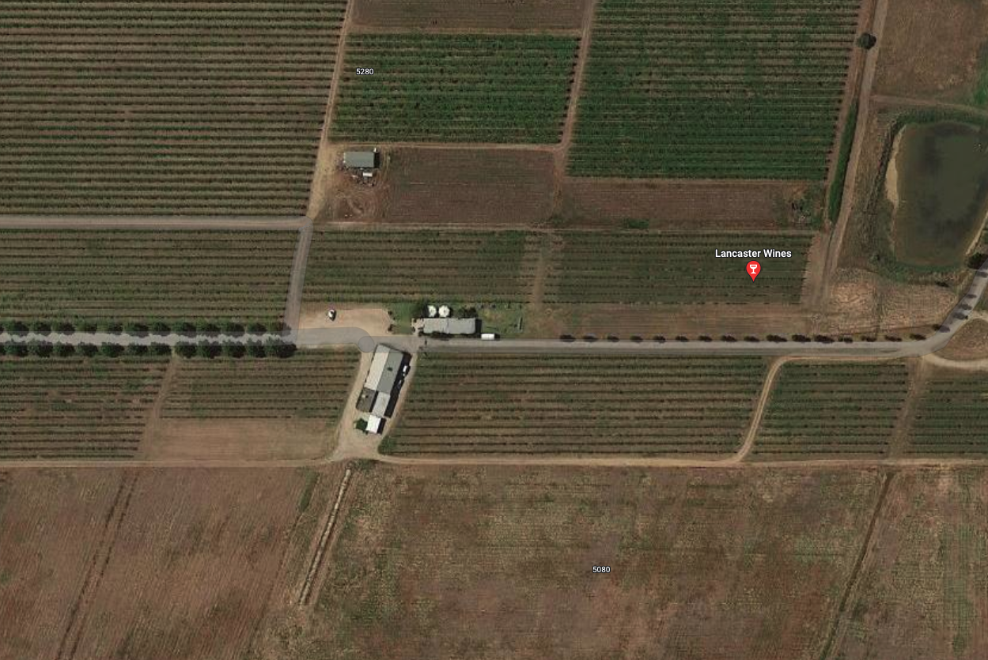
Oh Maybe? Are those tables?

Slide 11
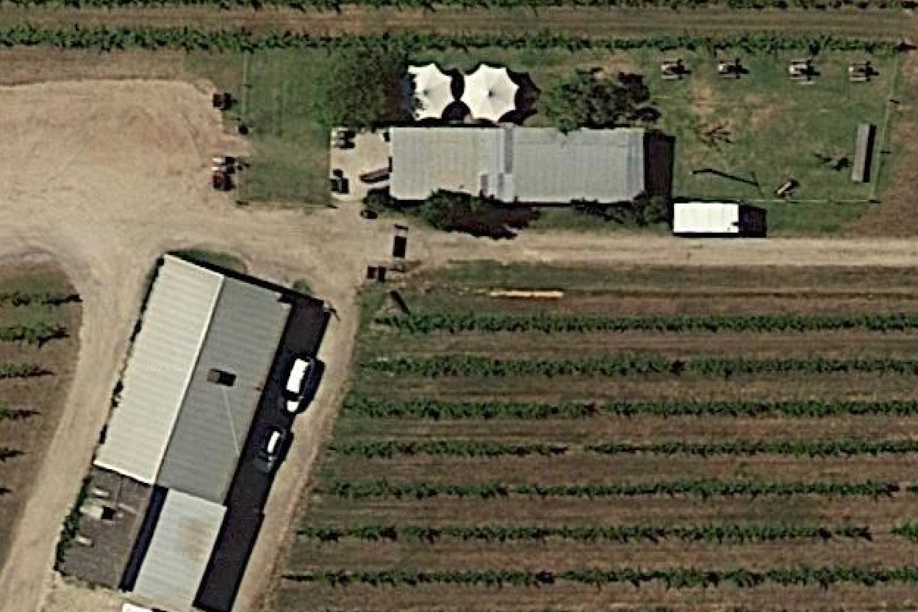
Umbrellas go over tables I guess?

Slide 12
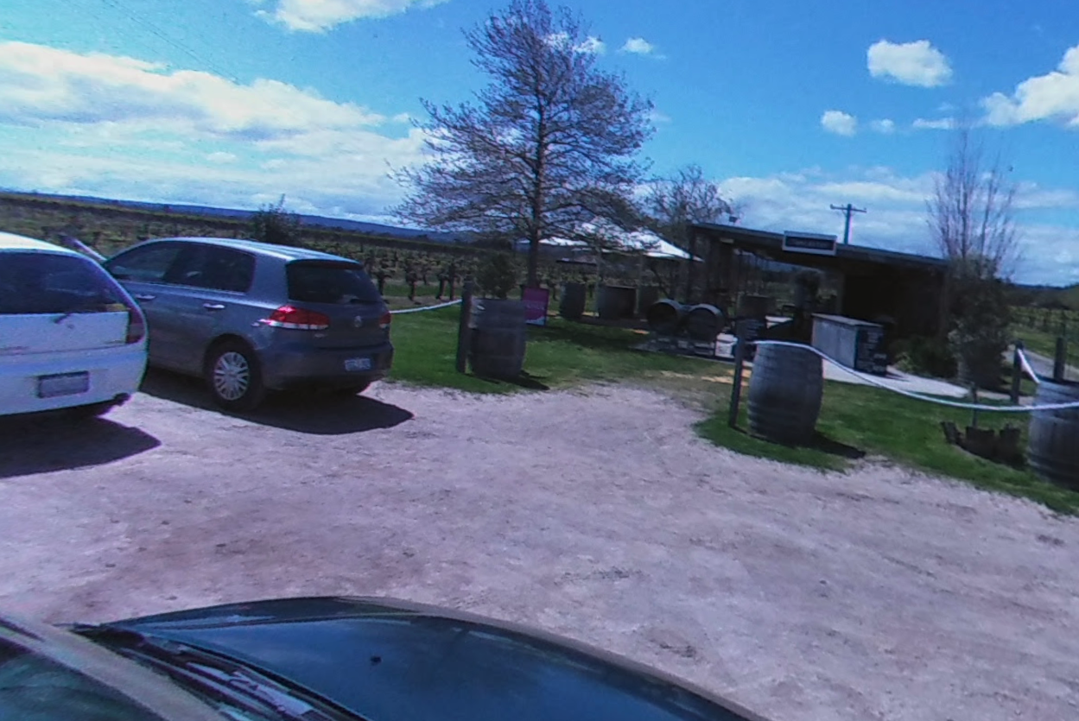
Aha! Yes! That’s the one!

Slide 13
Research Question
Given partial information, how much of the last-mile discovery of a location can be automated?
Does automating this last-mile discovery help humans find things?

Slide 14
Background
Why should it work?
Geoguessr case studies.
The Winthrop Method.
The Hippocampus & Memory.
Related Disciplines:
Remote Sensing Imagery
Visual Question Answering
Geospatial Question Answering

Slide 15
ARCHITECTURE

Slide 16

Required System Components
Locations
Search
“Winery near Perth with wine barrel tables”
Ownership Assignment
Concept Mapping
Objects

Slide 17
1. Data Collection & Storage
Google Maps has locations. Some objects weakly inferred from text descriptions.
Open Street Maps has some locations and some objects. All crowd-sourced.
Gap: Automatic object detection, labelling and geo-reconciliation.
Locations
Objects

Slide 18
2. Ownership Assignment
Given locations, and sets of objects, which objects belong to which location?
Trivial where location bounding boxes exist.
More difficult where only ‘point’ data exists for locations.
Approximation ok – human eye / memory doesn’t care about property boundaries.
Locations
Ownership Assignment
Objects

Slide 19
3. Concept Mapping
Intra-location object locations contain key information.
A list of member objects is good, but a representation that can be queried geographically is better.
“Winery with Palm trees and Fountain”
vs
“Winery with palm trees on south boundary and a fountain to the east of the house”
Vs
“Winery with palm trees to the left of the front door and a fountain out the back”
Ownership Assignment
Concept Mapping

Slide 20
4. Searching
Aspire to Natural Language Querying
SQL / SPARQL or similar good.
Open Street Maps has a pretty good object search API already!
No location – object ownership
No concept mapping queries
Search
“Winery near Perth with wine barrel tables”
Concept Mapping

Slide 21
Why care about a system like GESTALT?
Humans don’t think in lat & long
Sometimes we remember the name of a place & can search exact match now!
Sometimes we only have partial information…
General Location
General Characteristic
Landmarks / Objects
Gestalt fills that last gap
Locations
Search
“Winery near Perth with wine barrel tables”
Ownership Assignment
Concept Mapping
Objects

Slide 22
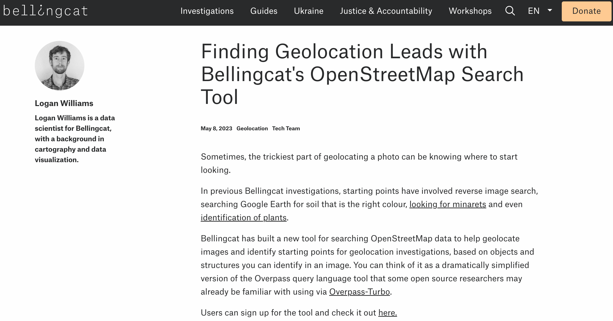
It turns out this is a really good idea…
May 8, 2023

Slide 23

All is not lost…
Tool is an abstraction of Open Street Maps API.
No solution for data collection
No solution for membership inferencing
No concept mapping
No user study
It DOES show there is a NEED

Slide 24
IMPLEMENTATION

Slide 25
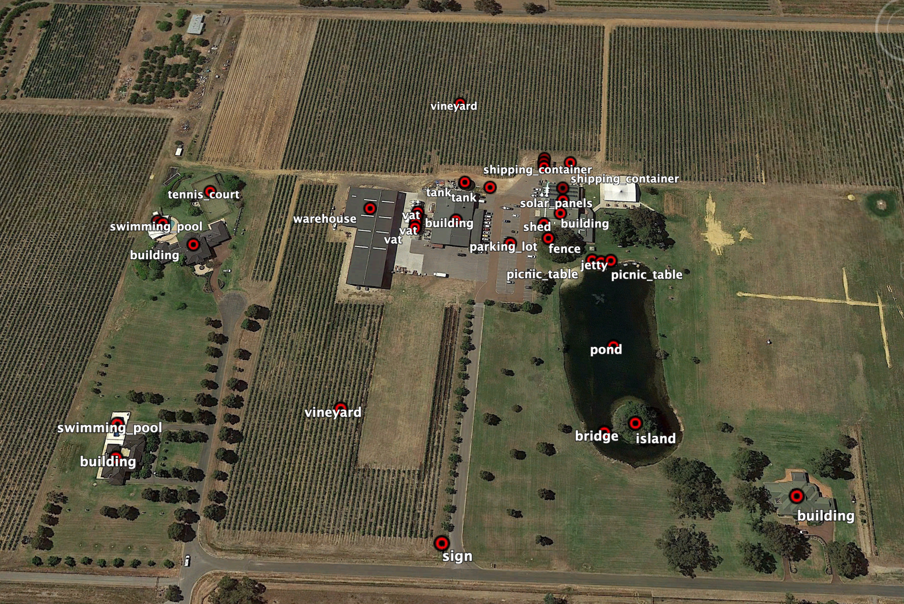
Data Collection & Storage
Locations
Objects
Objects (~150):
Manual Labelling using google earth
Stored as KML
Parsed into pandas data frames
Locations (~30):
Wineries contributed to Open Street maps
API Querying of OSM
Parsed into pandas data frame

Slide 26



Demo (Data Extraction)
So what?:
If you can label in OSM, do it.
If you can’t the GESTALT Pipeline will get it from KML or OSM into a common format.

Slide 27
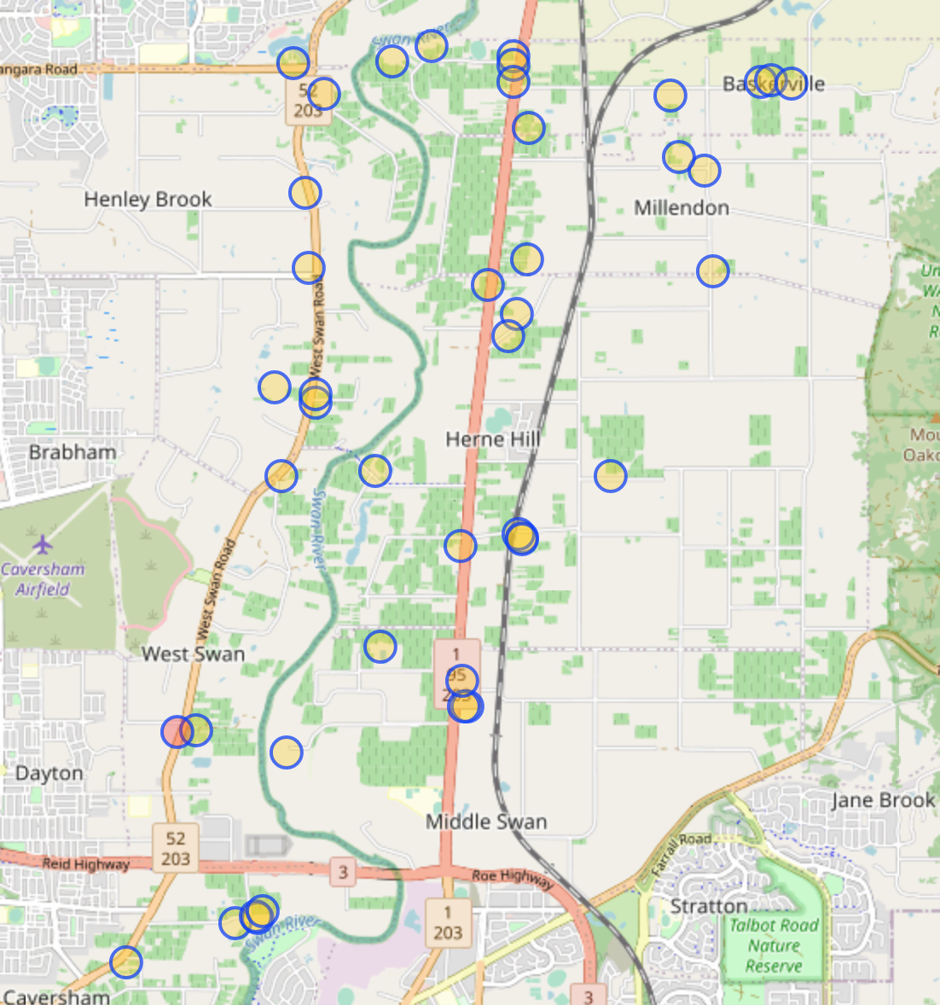
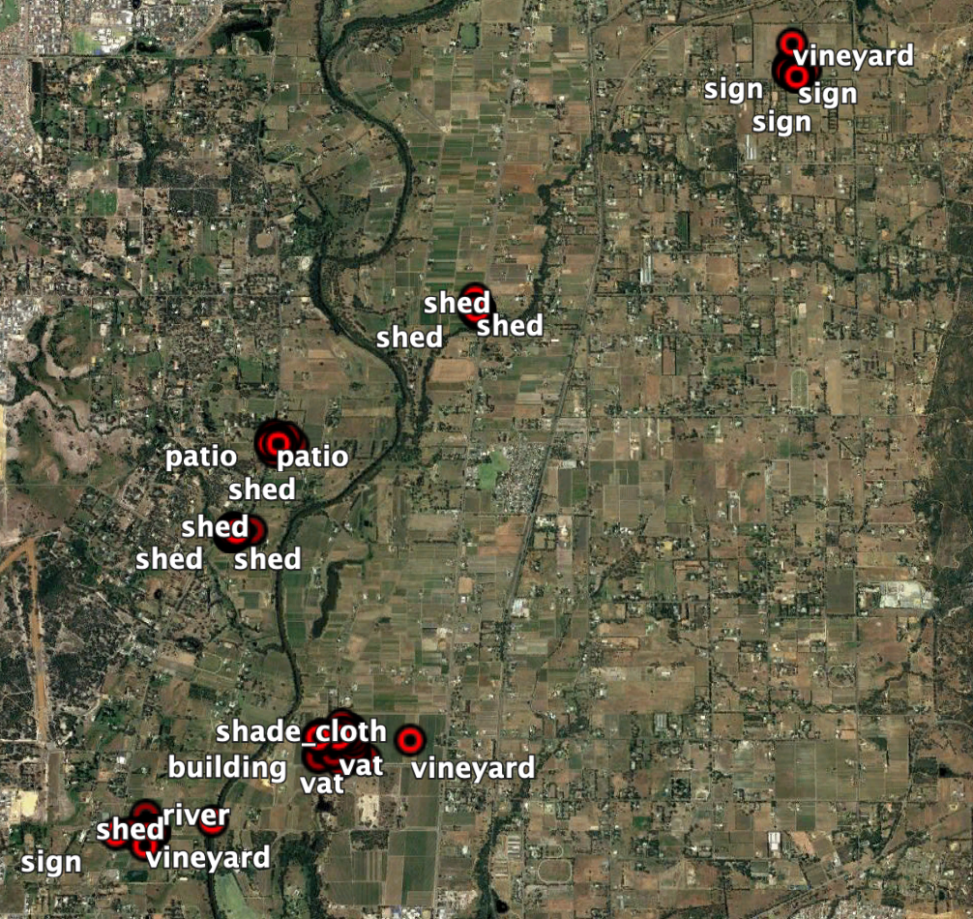
Ownership Assignment
Locations
Ownership Assignment
Objects
Bounding Box locations (Trivial):
If in bounding box assign membership.
Point locations (Harder).
Ph 1. Clustering. Trialed two approaches:
K-Means Clustering of objects
DBSCAN Clustering of objects
Ph 2. Inference.
Given KD-Tree of Locations, Nearest neighbor search for each cluster centroid to each known location.
An unusual clustering problem
Know all possible centroids.
Not all centroids will have objects.

Slide 28
Demo (Ownership Assignment)
So what?:
Kmeans will work IF you know the number of clusters you’re adding in advance
DBScan will fail with great variance in location dispersion
An ideal algorithm will known possible cluster locs, then cluster around them

Slide 29
Concept Mapping
Ownership Assignment
Concept Mapping
Rudimentary
Based on Lat / Long Arithmetic
Graphical Model likely to work better at small scale (NN inference)
For arbitrary size, Point Quadtree may be better.

Slide 30
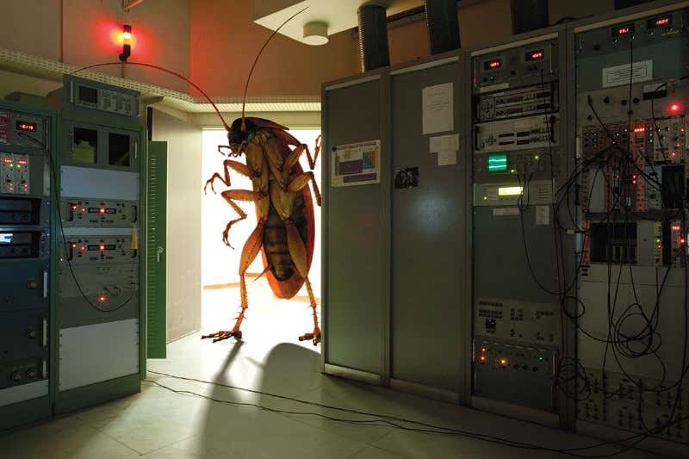
Demo (Concept Mapping)
So What
Needs to be absolute (NSEW) and relative (Left, Right, Behind) for any object (or set of objects)
Needs to aggregate at scale
Image Source: https://www.newscientist.com/article/mg22830501-100-want-a-computer-that-never-crashes-dont-let-bugs-freak-it-out/

Slide 31
Querying
So what?:
Need to move towards Natural Language Queries
If not, adopt the use of the OSM Ontology to improve search & Add semantic search

Slide 32
Limitations
Data Acquisition currently very manual
OSM is good start, but sparse.
RSI Object Labelling is not suitable for this task.
We can better leverage available imagery.
Ownership Inferencing imperfect:
KMeans assumes known number of clusters.
DBScan fails when locations are close (within threshold)
Concept Mapping very limited
Dynamic generation not implemented
Sub-Optimal data structure in use
Querying
User-friendly interface required.
Usability
No ‘real’ evidence that it will help users.

Slide 33
Future Work
Automate the labelling and geo-reconciliation of objects
Use RSI to get rough X,Y Map of ‘things’
Use photos from known locations to infer object to position match-ups.
Improve ownership inference by implementing a variant of DBScan with known centroid locations
(i.e. define where clusters have to form around)
Implement Point Quadtree Data Structure for on-the-fly cardinal direction referencing.
Conduct User Study to determine:
Does the GESTALT approach actually reduce the amount of time to find locations
What objects / features do people actually remember?

Slide 34
Summary
How much of the last mile search can we automate?
Not as much of the collection as we need to
The membership inferencing is close, as is the concept mapping
Quite distant on the Natural language querying
Will this actually help people?
Neuroscience and battlefield experience suggest yes
Bellingcat making a tool for it suggest yes
But… we don’t know yet.

Slide 35
Options towards getting something publishable…
User Study:
Does the ‘last mile’ search help users to find locations more quickly than they otherwise would?
What features are users most likely to remember about a given locations.
DBScan Variant:
Implement a working approach.
Experimental comparison to other algorithms
Demonstrate the ability to geo-reconcile objects by combining Remote Sensing Imagery and Ground-Level Photography.
A hard problem.

